Slide 1

Effectiveness of benefit targeting
Korea-Australia Tax Symposium – Nov-2024
Pelin Akyol, Erin Clarke, Gianni La Cava, and Matt Nolan

Slide 2
Motivation: Reforming social security into “unemployment insurance”
New Zealand Unemployment Insurance proposal
A belief that wage scarring is high.
That wage scarring is a product of “insufficient insurance” and “poor match quality”.
That providing greater social insurance to “pool risk” would reduce such scarring.
Motivated a scheme offering 80% replacement rate for six months, without search requirements, for all individual up to the top 2% of the wage distribution.
None of these have been shown empirically in New Zealand or in Australia (who have similar benefit systems).
Policy also has been raised in Australia with a focus on match quality (JobMatcher - Blueprint 2021)
Although the evidence base is larger in Australia (thanks to work by TTPI and Melbourne Institute),
there are still areas to investigate this further before it is raised again.
Wage scarring estimates and the role of match quality. Appendix.
Labour supply responses to replacement rate changes. Appendix.
Expenditure/consumption responses to job loss (the focus today).

Slide 3
Question for today
Are JSP eligibility rules “well targeted”
Aim to answer this by asking:
What are the expenditure responses to job loss?
How do these expenditure responses differ by benefit status and family status?
How much is this a reduction in income vs a reduction in work related expenses?
The idea is that, if those who don’t receive the JSP on job loss don’t reduce consumption
then the selection criteria are excluding those who are already insured against such loss.
By not paying benefits to those who are already insured we improve targeting efficiency – supporting those that require the payment at a lower fiscal cost.

Slide 4
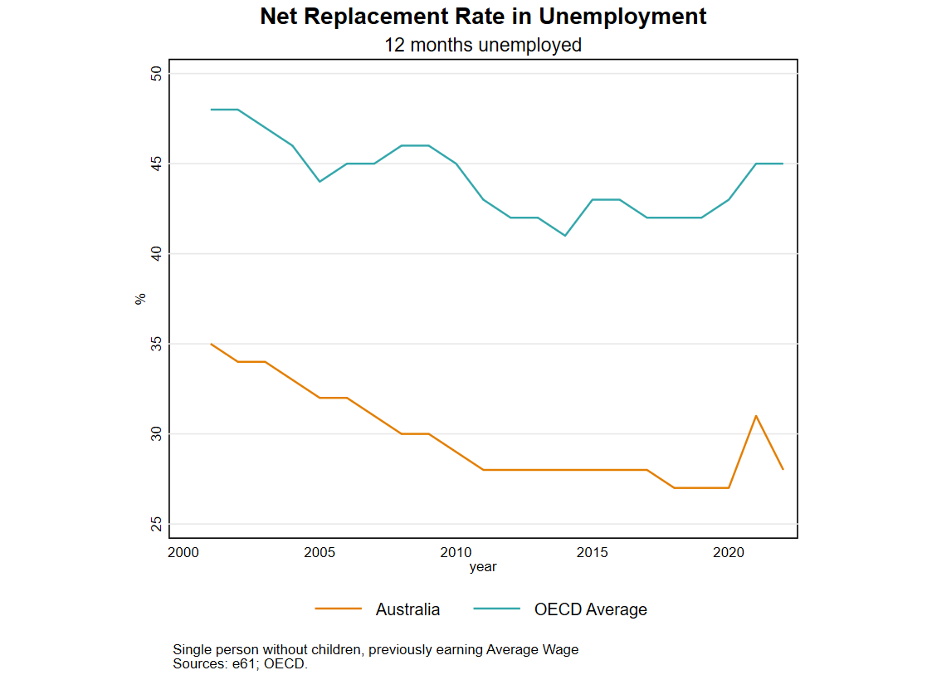
Insurance and optimal benefits
Permanent income hypothesis (PIH) – if job loss is a temporary income shock there
should be a limited change in consumption.
If individuals can perfectly insure against job loss risk, there should be no change in consumption from job loss.
Consumption changes can be used to understand more about the nature of job loss.
Evidence of government and family insurance against income shocks in general (Tin and Tran 2023).
Evidence of household insurance ends up similar to the US (Morley et al 2024).
Baily-Chetty result: Consumption response to job loss can be used to calculate the optimal benefit level (along with an estimate of labour supply responses). [not value of leisure or match quality]

Slide 5
Summary
Methods
Expenditure scars: Event study estimate of the dynamic path of expenditure for those who lose their job, relative to those who don’t.
Separating final and intermediate consumption: Instrumental variable approach to estimate the expenditure decline due to working from home.
Answer: Benefit targeting looks effective at reducing fiscal costs while targeting those who need the additional insurance – especially among those who are in a relationship.
Results
Expenditure declines persistently – by about 10% - following the experience of job loss.
Elevated job loss expectations explain part of the initial decline.
Voluntarily displaced individuals, and individuals who don’t take up benefits, experience smaller declines.
Work related expenses appear to explain most of the initial decline in expenditure for non-recipients.

Slide 6
Measuring a consumption scar?

Slide 7
Data
Estimates use the Household, Income and Labour Dynamics in Australia (HILDA) survey.
Statistics
Uses data between 2005 and 2019.
Focused on individuals aged between 25 and 54.
Expenditure is non-durable spending, annualised.
Job loss defined as a transition from employment to unemployment (not NILF) for the head of the household.
636 treated individuals.
When comparing benefit recipients to non-recipients.
Recipients: Those who receive JSP/NSA in the year of first job loss – 178 individuals.
Non-recipients: Those who do not receive any first income support payment (includes DSP) – 434 individuals.
Main estimates use an unbalanced panel.
A panel balanced for the 9 years around event time gives similar results (Appendix).

Slide 8
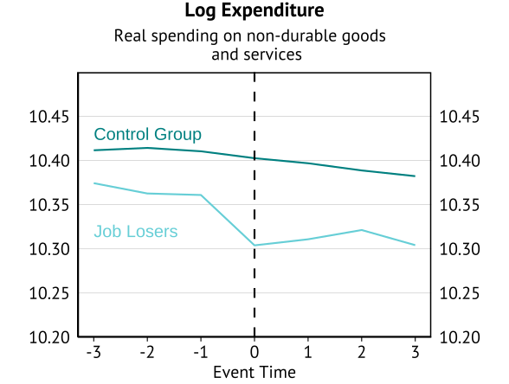
Data
Estimates use the Household, Income and Labour Dynamics in Australia (HILDA) survey.

Slide 9
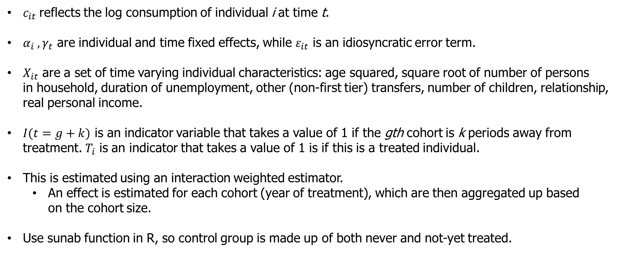
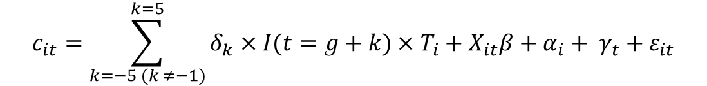
Approach
Staggered Event Study (a la Sun and Abraham 2021)
$$c_{it}=\sum_{k=−5 (k ≠−1)}^{k=5}{δ_{k}×I(t=g+k)}×T_{i}+X_{it}β+α_{i}+ γ_{t}+ε_{it}$$
$c_{it}$reflects the log consumption of individual i at time t.
$α_{i} ,γ_{t}$ are individual and time fixed effects, while $ε_{it}$ is an idiosyncratic error term.
$X_{it}$ are a set of time varying individual characteristics: age squared, square root of number of persons in household, duration of unemployment, other (non-first tier) transfers, number of children, relationship, real personal income.
$I(t=g+k)$ is an indicator variable that takes a value of 1 if the gth cohort is k periods away from treatment. $T_{i}$ is an indicator that takes a value of 1 is if this is a treated individual.
This is estimated using an interaction weighted estimator.
An effect is estimated for each cohort (year of treatment), which are then aggregated up based on the cohort size.
Use sunab function in R, so control group is made up of both never and not-yet treated.

Slide 10
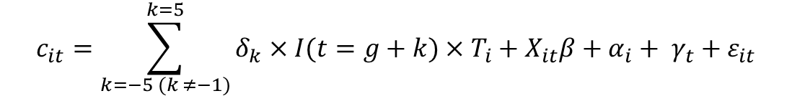
Approach
Staggered Event Study (a la Sun and Abraham 2021)
$$c_{it}=\sum_{k=−5 (k ≠−1)}^{k=5}{δ_{k}×I(t=g+k)}×T_{i}+X_{it}β+α_{i}+ γ_{t}+ε_{it}$$
Interpretation
Is job loss an exogenous event. No. This is not a causal estimate of the consumption decline from job loss. [Note: Involuntary job loss does lead to larger expenditure declines]
This does not tell us how consumption would change if the benefit rate changed (i.e. Gruber 1997).
It does tell us that, given the current benefit structure, individuals who transition into job loss reduce their expenditure by this amount – on average.
Purpose: If there was uninsurance we would expect to see a large consumption drop around job loss.
For benefit recipients this speaks to how much they are insured included the benefit payment.
For non-recipients this speaks to the role of targeting.

Slide 11

Why would expenditure change after job loss?
Lower lifetime income
Insufficient liquidity
Uncertainty
Lower expenses (work related costs)

Slide 12
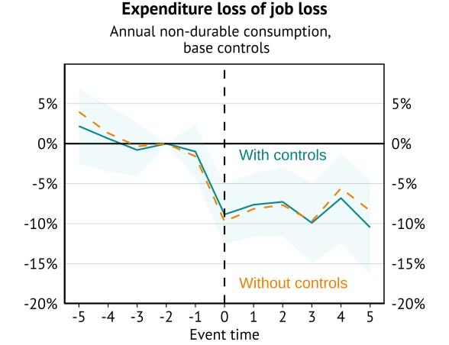
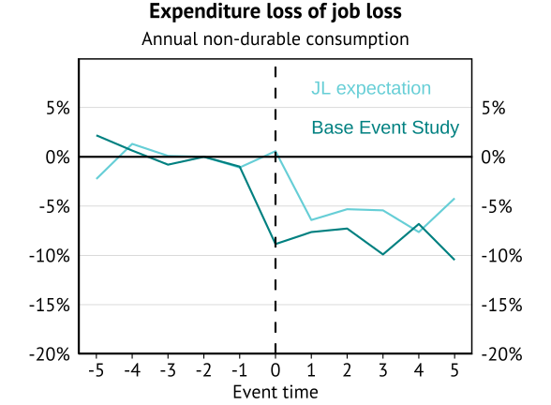
Expenditure Scar
Scars controlling for personal characteristics and income. Additionally controlling for subjective job loss risk.
Future job-loss risk only explains a small amount of the decline in consumption.

Slide 13
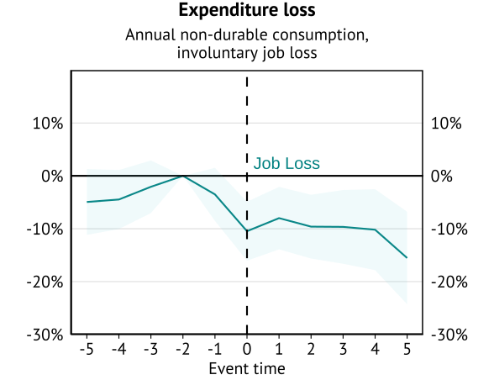
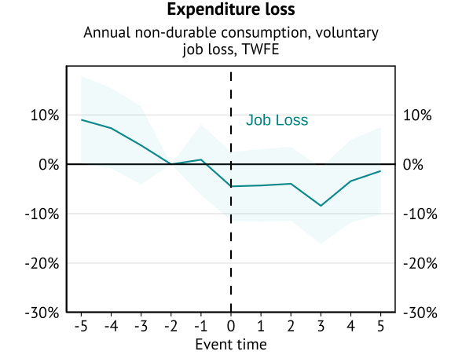
Type of unemployment scar
Involuntary job loss
Voluntary job loss

Slide 14
Beneficiary consumption scarring

Slide 15

Individuals, government, determine whether you receive income support
Job loss
Benefit application
Approval
Non-receipt
No application
Non-receipt
Our intention is to describe the selection involved in being approved or not approved (not a causal estimate).

Slide 16
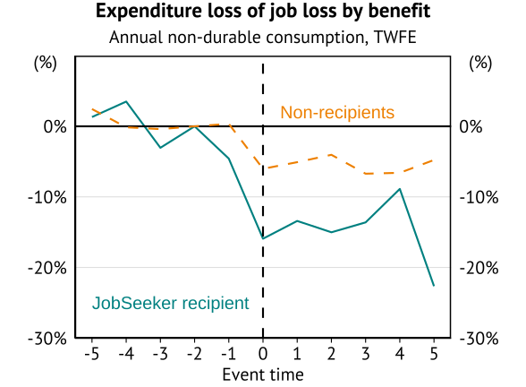
Benefit type
Would we expect benefit recipients to see a smaller or larger scar?
Receiving the payment reduces the liquidity constraint.
Subject of Clarke et al (2023).
Eligibility and take-up correlated with liquidity constraints (selection).
Much larger decline in consumption for those who receive income support.
Insufficient payment?
Insufficient coverage?
Heterogeneity.

Slide 17
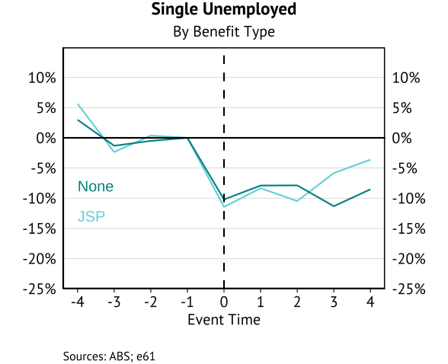
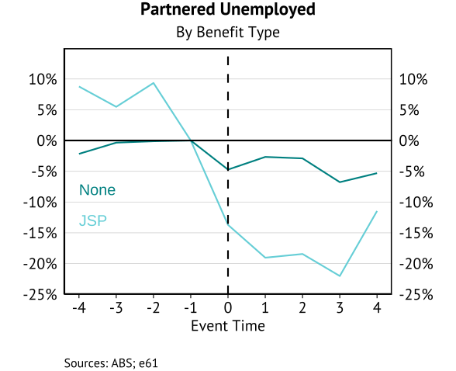
Benefit type: Partnership status
Entire difference due to individuals who are partnered who take-up the payment
Limited partnered non-recipient response indicates that partner income testing may be appropriate.
Large response by partnered recipients suggests that this group is significantly constrained after a job loss shock - may motivate higher couple payments

Slide 18
Lessons from working from home

Slide 19
Why would expenditure change after job loss?
Lower lifetime income
Insufficient liquidity
Uncertainty
Lower expenses (work related costs)

Slide 20
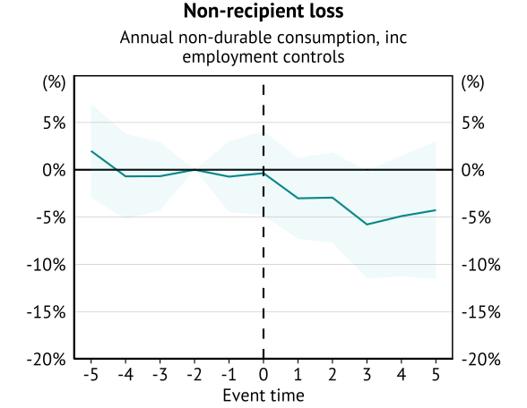
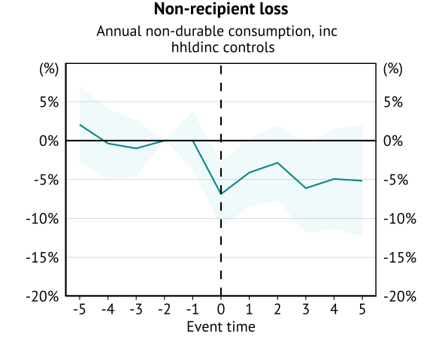
Non-recipients and the role of employment
Conditional on employment
Conditional on household income

Slide 21
Work related expenses
Why has consumption declined?
Tax deductions suggest work related expenses matter – don’t want to tax these expenses:
US standard deduction – 35% of average earnings, 23% of average FT earnings.
Australian tax-free threshold – 19% of average FT earnings (other deductions allowed).
So tax authorities say that “income” to pay for work related expenses aren’t income!
Without a job there is no need to pay work-related expenses. As a result, some of the expenditure decline is not a decline in consumption.

Slide 22
Work related expenses
We can’t just look at consumption decline on job loss.
Expenditure decline is BOTH due to lower consumption and lower work-related expenses.
Lessons from retirement.
Predictable exit from the labour market.
Hurst (2008) – expenditure decline is NOT a decline in consumption.
Combination of reduced work-related expenses and time to search for good deals.
What about lessons from working from home?
Suddenly working from home implies that some work-related expenses no longer occur (travel).
COVID as shock.
Will understate savings (time budget, cost of working from home).

Slide 23
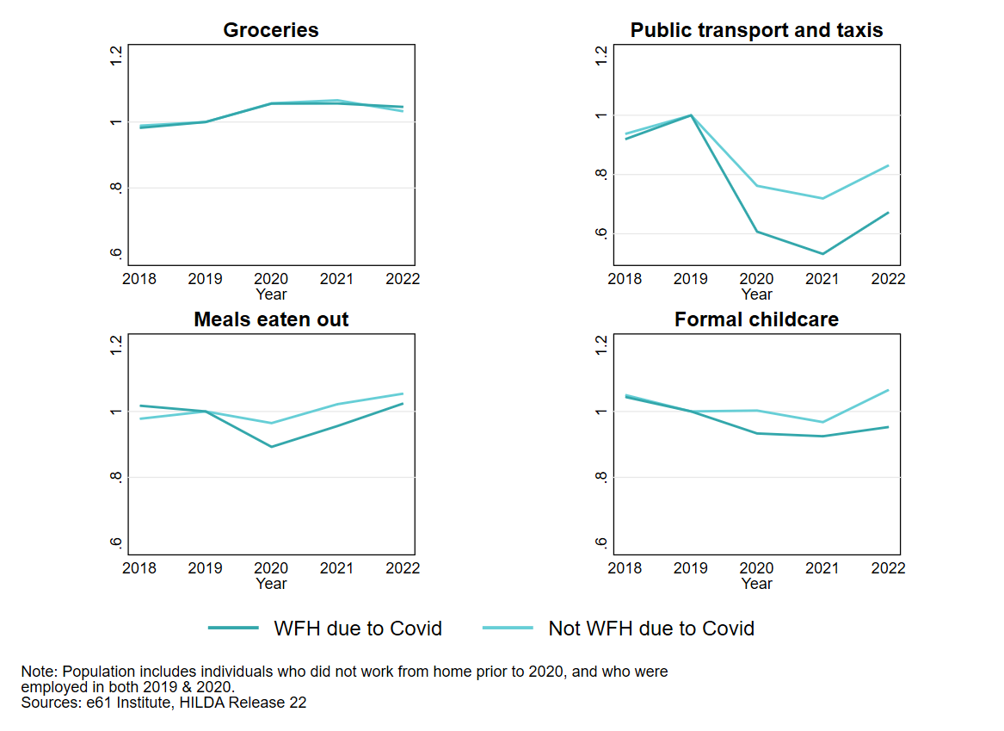
COVID Working from home
How much of the spending decline is due to no longer having to go to work?
Clear categories where spending did drop when working from home.
Selection into working from home!
Preferences
Policy
WFH due to COVID likely not exogenous

Slide 24
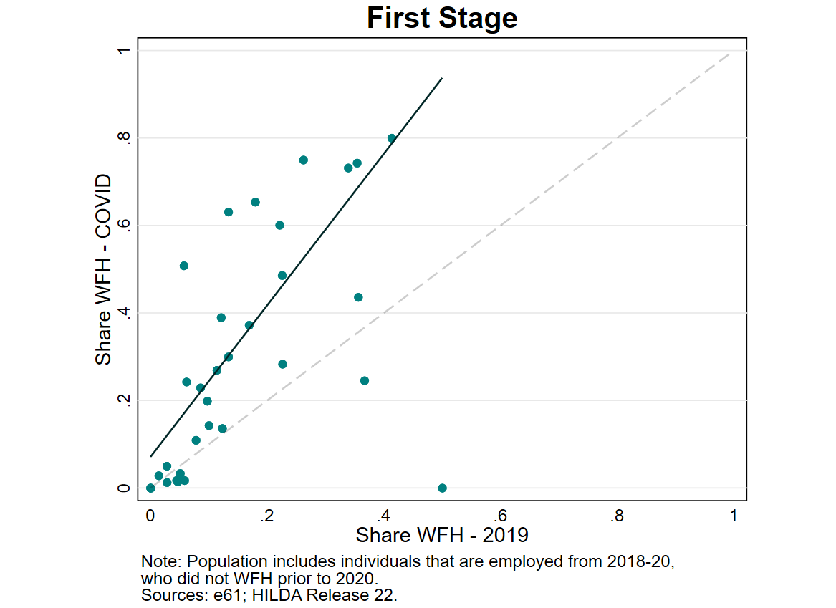
First stage
Our sample is all individuals who are employed and don’t work from home in FY18 and FY19.
Instrument is the industry-occupation level share of employees working from home in 2019 (for all employees).
For relevance, we would need the probability of working from home in 2020 to increase with the industry-occupation share.
F-stat: 218 (not a weak instrument).
A 10ppt increase in the ind:occ share of individuals working from home increases WFH probabilities by 4.1ppt.
Exclusion: prior industry-occupation must not influence consumption directly (control channels).
Job-loss risk.
Income and employment status.

Slide 25
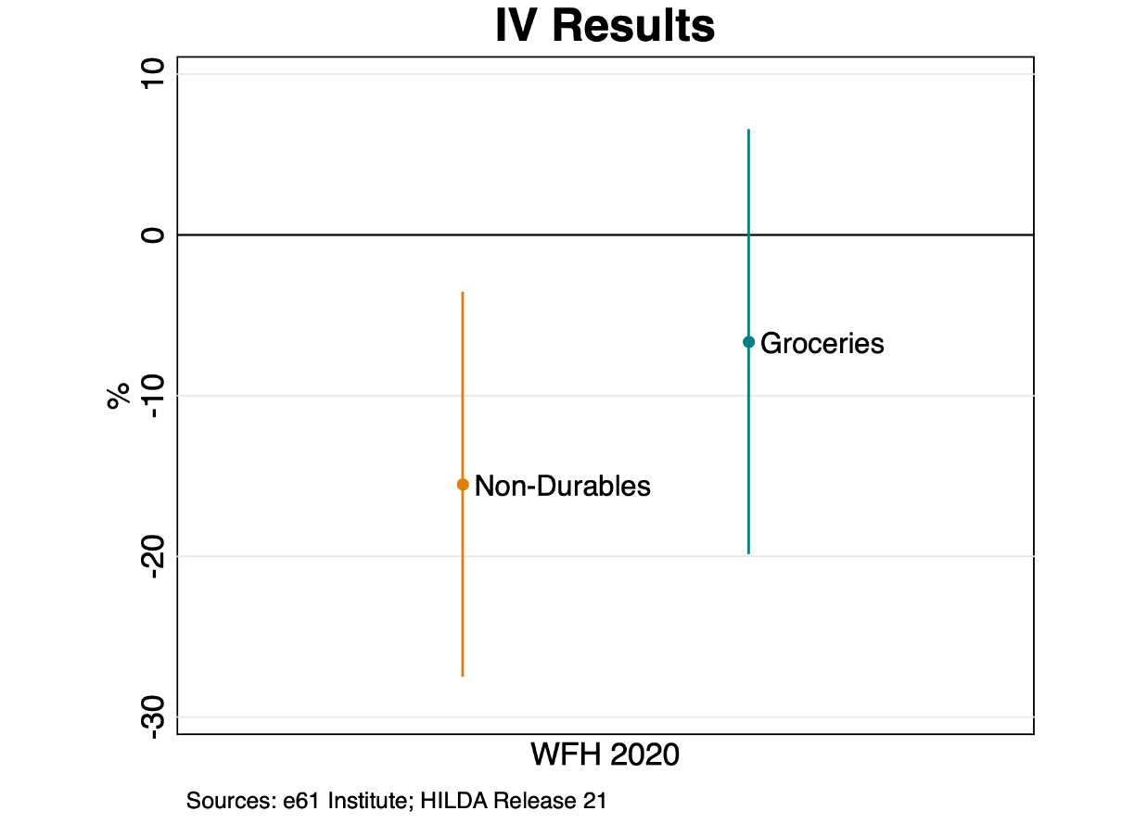
COVID Working from home
Selection into Working From Home not Exogenous – IV approach
$$h_{i}={ξ+γz_{i}+ βX}_{i}+ε_{it}$$
$${∆c}_{i}={α+θ{\hat{h}}_{i}+ δX}_{i}+ε_{i}$$
Use pre-COVID industry share as an instrument for working from home.
Initial estimate is a 15% decline in expenditure, however very imprecise.
OLS estimates are a 5% decline.
Grocery spending (which is seen as less work related) does not experience a statistically significant decline (6.6% reduction).
Scaling for time out of work, this explains 83% of the expenditure decline for non-beneficiaries.

Slide 26
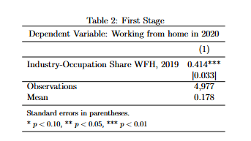
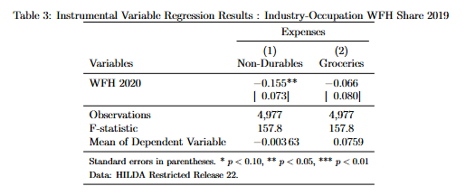
COVID Working from home
Selection into Working From Home not Exogenous – IV approach
$$h_{i}={ξ+γz_{i}+ βX}_{i}+ε_{it}$$
$${∆c}_{i}={α+θ{\hat{h}}_{i}+ δX}_{i}+ε_{i}$$
Scaling for time out of work, this explains 83% of the expenditure decline for non-beneficiaries.

Slide 27
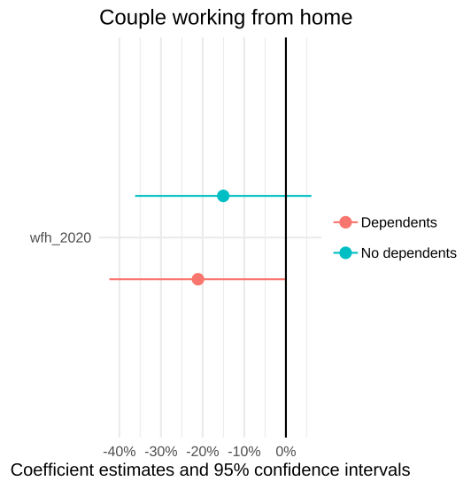
COVID Working from home
Selection into Working From Home not Exogenous – IV approach
Consumption response stronger for partnered households
17% reduction in spending when WFH – 15% for those without children, and 21% for those with children.
Note: Household consumption, but this is just the individual working from home.
Response much weaker for single individuals (2%, insignificant).
Although sole parents have a large estimated response (17%) there are few observations and the instrument is weak.

Slide 28
Conclusion

Slide 29
Key lessons
General findings for Australia: Expenditure declines persistently – by about 10% - following the experience of job loss.
Other lessons
Elevated job loss expectations explain part of the decline.
Voluntarily displaced individuals, and individuals who don’t take up benefits, experience smaller declines.
Work related expenses appear to explain most of the initial decline in expenditure.
Conclusion: High level evidence that current benefit targeting is appropriate – especially for couples.

Slide 30
APPENDIX

Slide 31
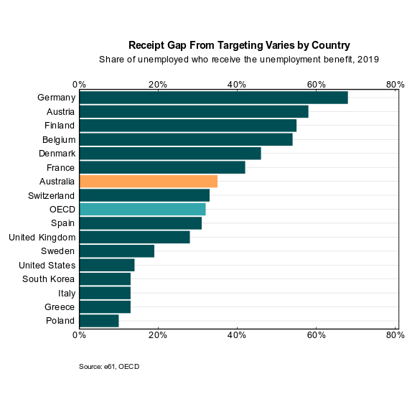
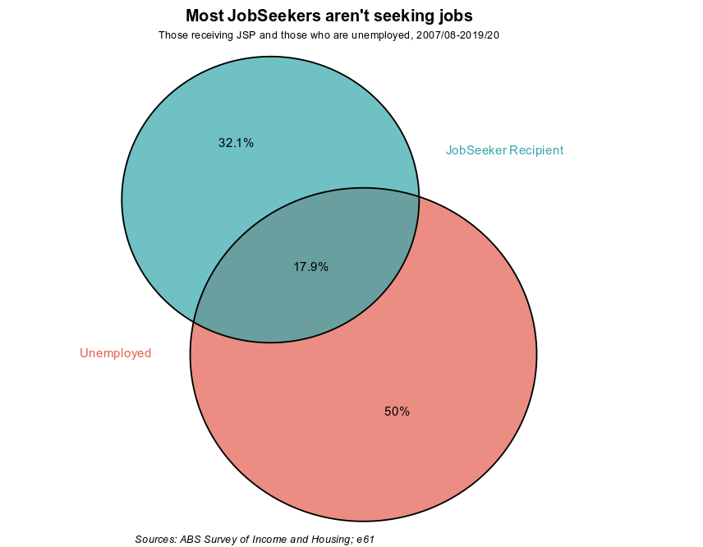
Background information

Slide 32
Not yet treated and balanced panel

Slide 33
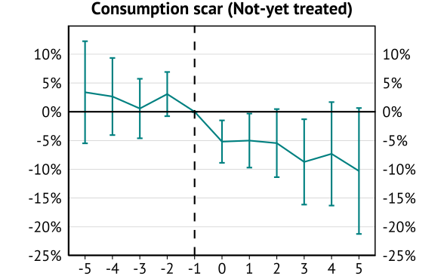
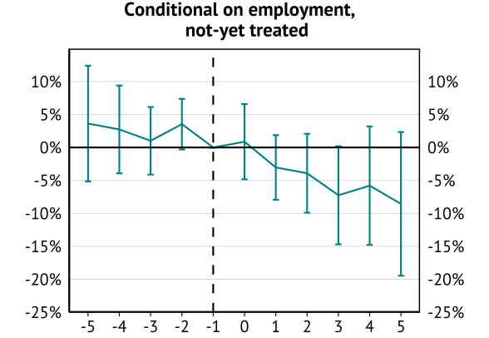
Not-yet treated

Slide 34
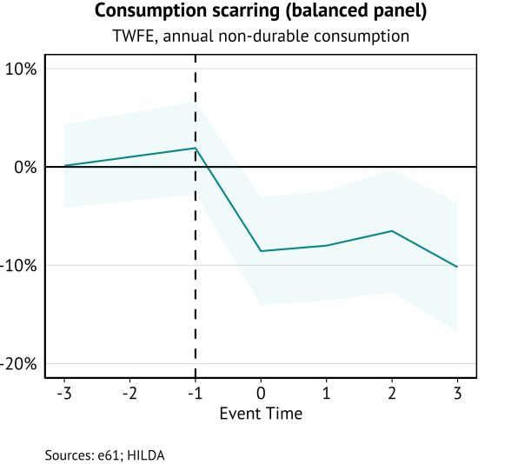
Balanced panel

Slide 35
Labour supply responses

Slide 36
Insurance and labour supply
How do benefits influence the incentive to work?
Baily-Chetty
Consumption responses after job loss reflect the potential “benefit” of a higher benefit rate.
However, total labour supply response is needed to reflect an important “cost” of higher benefits.
Work underway on labour supply
Intensive margin response to benefit abatement.
COVID benefit change.

Slide 37
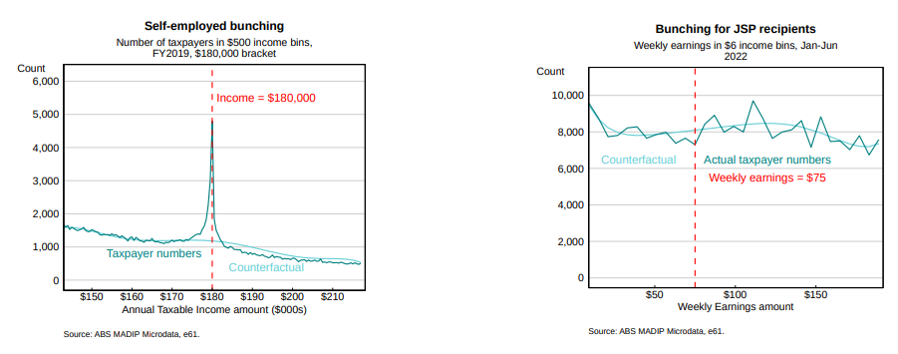
Do beneficiaries “bunch” at the abatement threshold?
No bunching – implies no intensive margin response to EMTR rise from 0% to 50%.
Similar results using DOMINO and other periods.
Similar lack of bunching found overseas.
Potential role of mutual obligations: Negative EMTR if benefit receipt relies on taking up a job.
“Extensive” participation margin is missing!

Slide 38
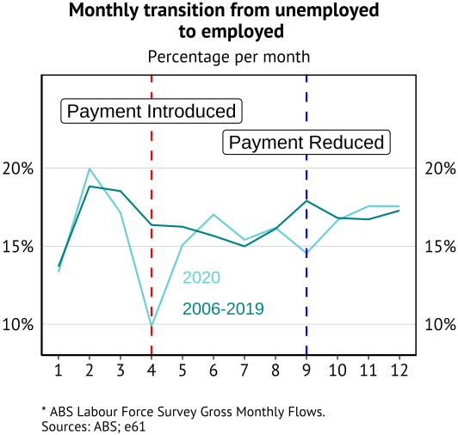
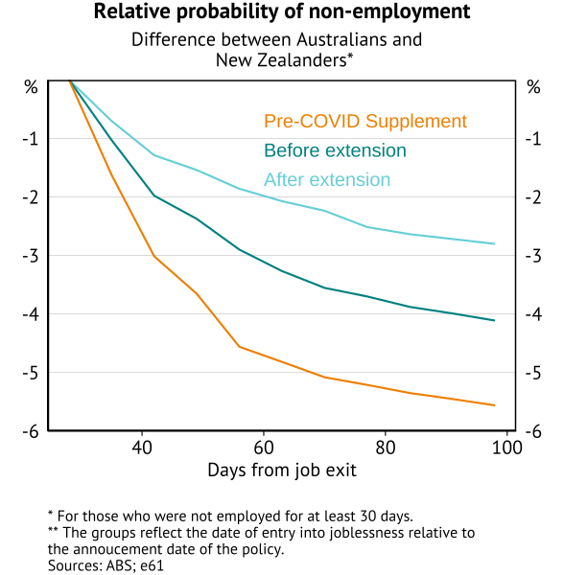
Extensive Margin: COVID Benefit Changes
Aim for release early-2025
Did the COVID supplement reduce labour market search/labour supply?
Borland (2020) – no appreciable difference in job-finding rates after benefit increase (ex March 2020)
What about announcement effects using high frequency (STP) data?

Slide 39
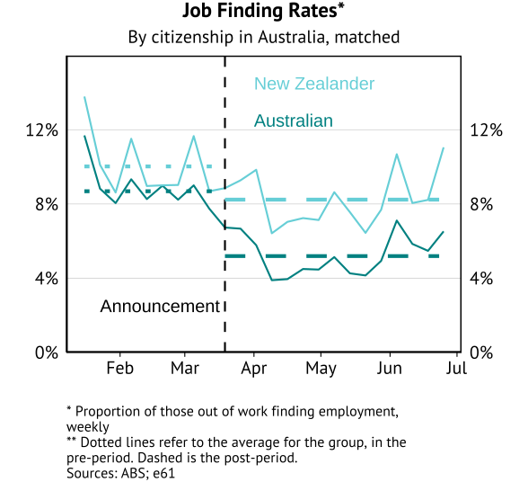
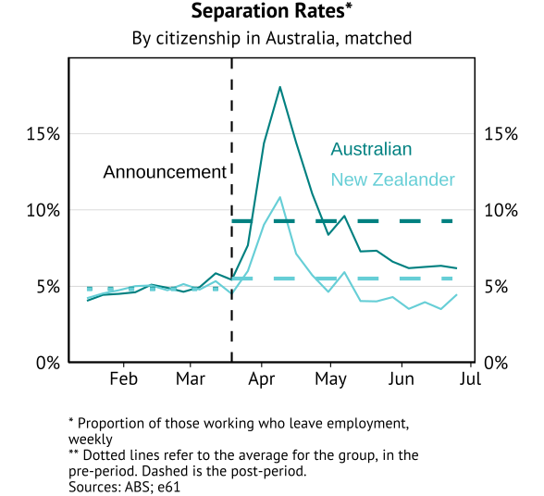
Extensive Margin: COVID Benefit Changes
Aim for release early-2025
Did the COVID supplement reduce labour market search/labour supply?
1.7ppt (19%) decline in JFR after announcement (both RDD and DiD estimate)
labour supply elasticity of -0.21%
3.7ppt (64%) increase in SR after announcement (RDD suggests 5ppt (106%)

Slide 40
Wage/income scarring

Slide 41
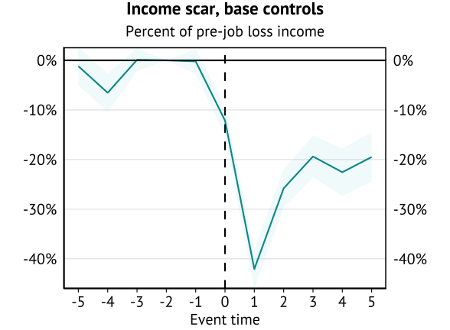
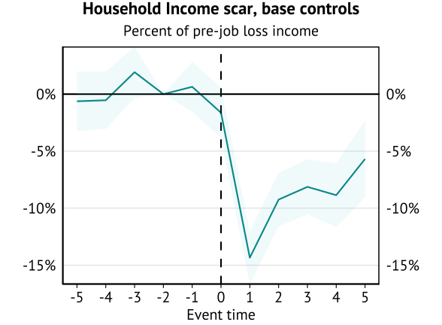
Income scarring from job loss (HILDA)
Individual wages and household incomes drop persistently following job loss.
Staggered Event Study (for consumption sample)
However, if this is a temporary drop in household income, we wouldn’t expect much of a change in consumption.
Implications for the “optimal” benefit level and coverage depend on how consumption will change.

Slide 42
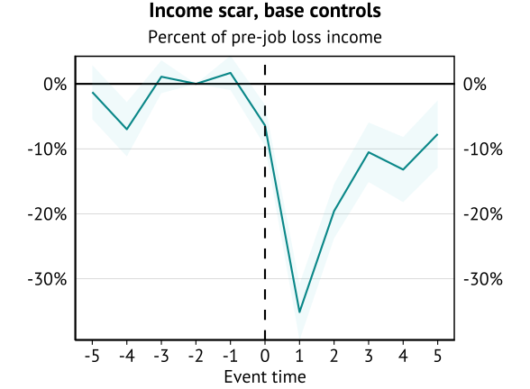
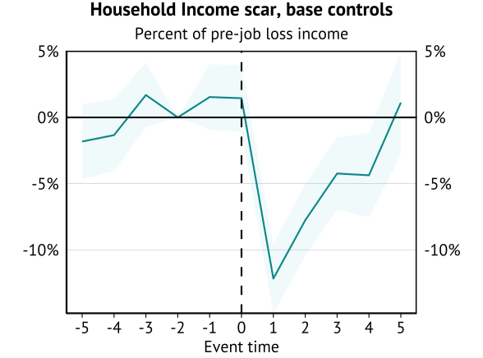
Income scarring from job loss for non-benefit recipient (HILDA)
Individual wages and household incomes drop persistently following job loss.
Staggered Event Study – non-benefit recipients

Slide 43
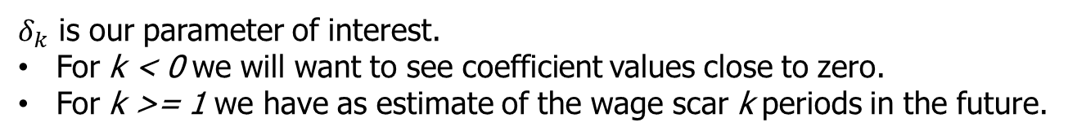
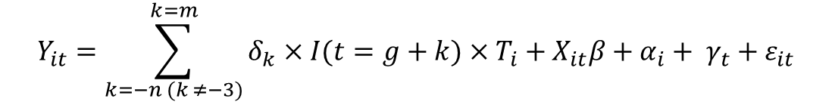
Event study approach – mass layoffs (PLIDA)
The base event studies (unless a TWFE approach is listed) use a Sun and Abraham (2020) interaction-weighted event study approach. The general specification is similar, with everything estimated at the individual:cohort level rather than individual level.
$$Y_{it}=\sum_{k=−n (k ≠−3)}^{k=m}{δ_{k}×I(t=g+k)}×T_{i}+X_{it}β+α_{i}+ γ_{t}+ε_{it}$$
Control units are matched individuals who are either never treated or not yet treated. Both treatment and
control individuals require six years of tenure and to be in a firm of sufficient size (to trigger a mass layoff)
Mass layoff is defined as a situation where a firm loses at least 30% of its staff in a given year, and does not rehire in the following year.
Here an individual's wage income in a given year is a function of time varying observable characteristics, time invariant characteristics, calendar time effects, and an idiosyncratic error term.
$δ_{k}$ is our parameter of interest.
For k < 0 we will want to see coefficient values close to zero.
For k >= 1 we have as estimate of the wage scar k periods in the future.

Slide 44
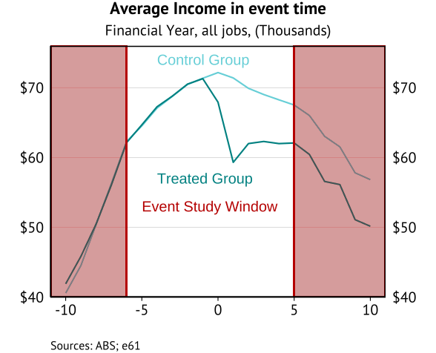
Outcome of group assignment
In the coming slides we will outline how the treatment and control groups are assigned.

Slide 45
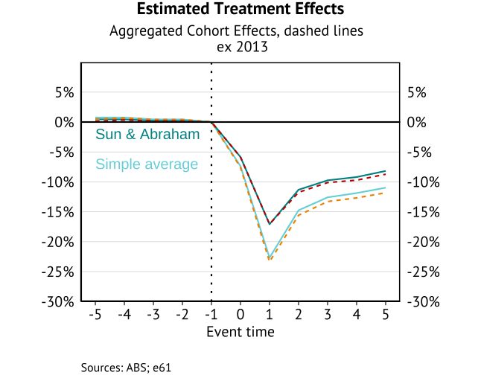
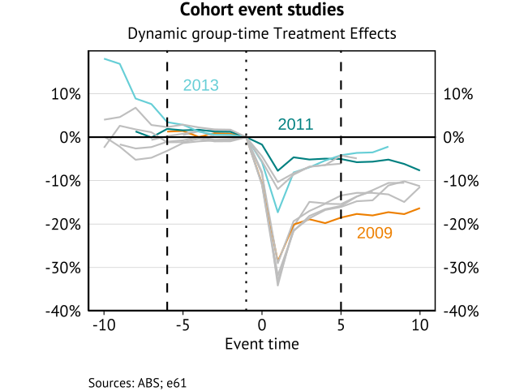
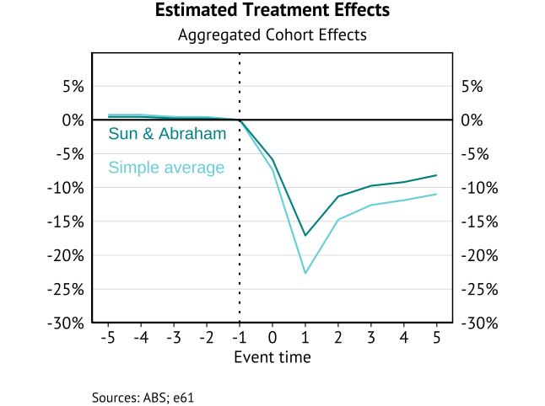
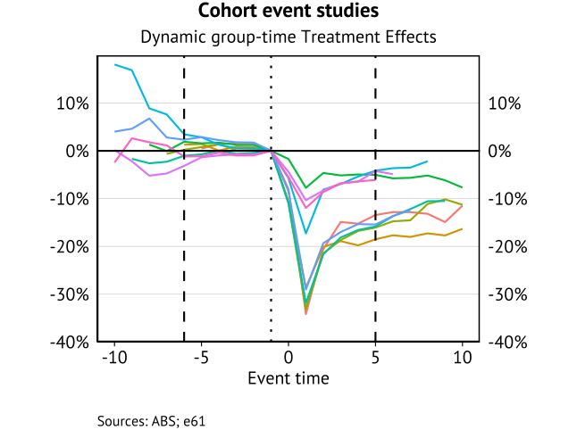
Group-time treatment effects – wage scars

Slide 46
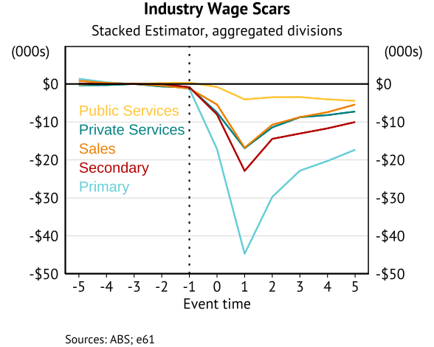
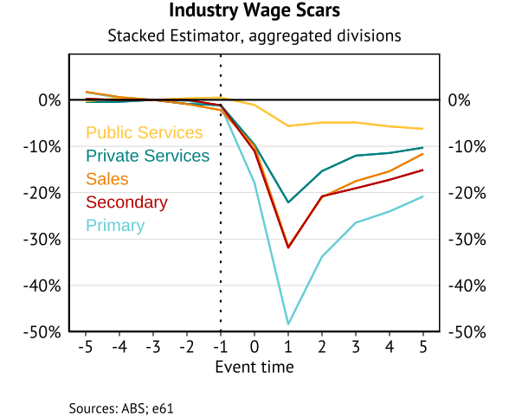
Heterogeneity – Industry results
At this stage we only have high level industry results
Primary industries (agriculture, mining) have a larger scars (as in Dwyer et al (2023) and IFS (2023)).
However, the trajectory by broad industry is similar.

Slide 47
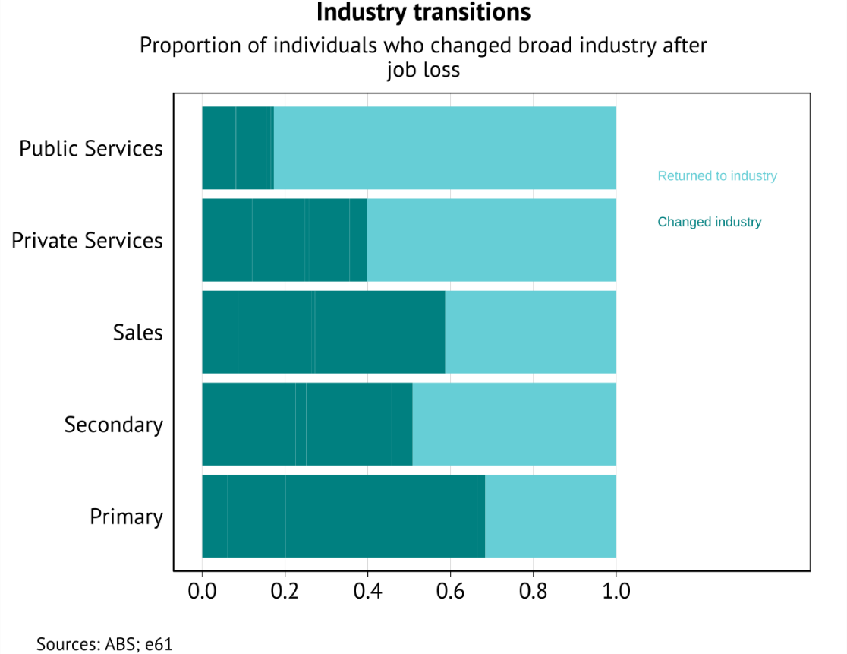
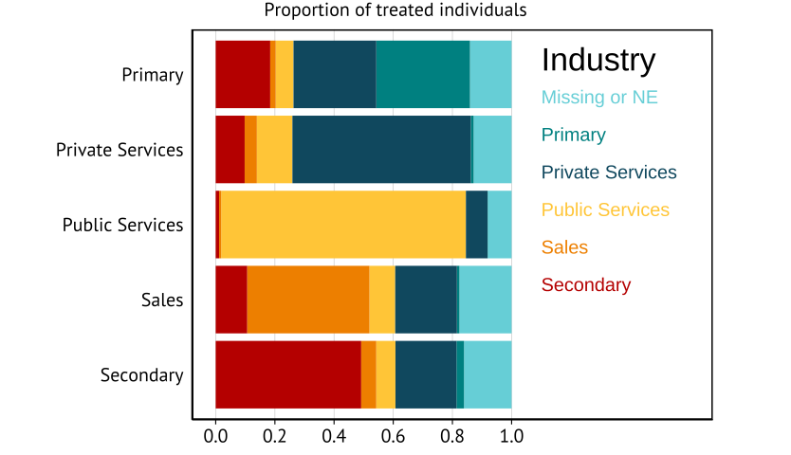
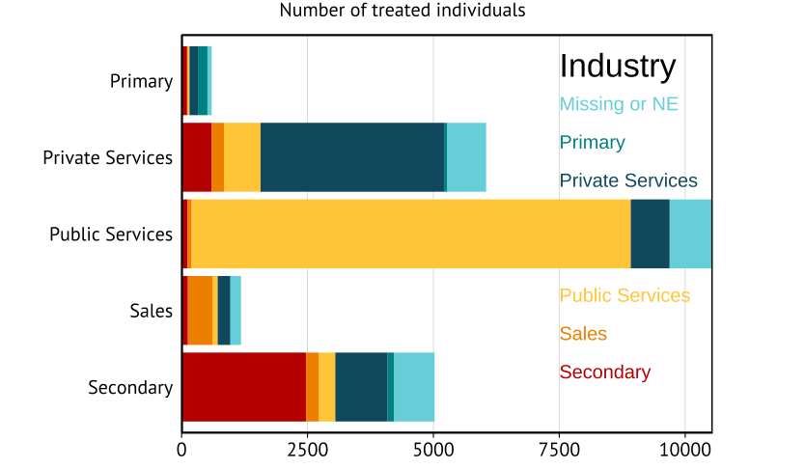
Heterogeneity – Industry mobility
Y-axis reflects industry prior to mass layoff, colour represents transition 5 years later.
Employment shares similar across industry groups (except primary which is much lower).
Long-tenure assumptions limit treated number from sales, expand numbers from public service
Larger scaring occurs in sectors where more individuals transition to another sector.

Slide 48
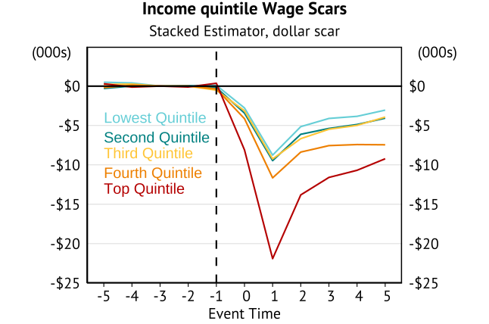
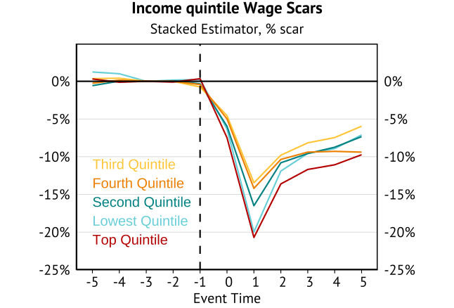
Heterogeneity – Income bins
Top and bottom quantile experiences the largest proportional scarring.
Differs from US results of similar distributional scarring (Rose & Shem-Tov 2023).

